Slide 1
Class Assignments
1 and 2 are due next week before class at 9am.
Assignment 1: provide an abstract of the project.
Assignment 2 was posted earlier this week and is complementary to assignment 1

Slide 2
Assignment 2
Which class dataset are you planning to use for your project? Please read in this dataset into Python and provide evidence of how big your population is. For example, if you are looking at abstracts in a specific year your population is the number of abstracts in that year.
What variables in the dataset are you planning to use? For each variable please provide descriptive statistics, such as the count of non-missing values and the mean/mean
Are there any outliers in the selection of the data for your analyses?
Do you have concerns about the quality of the data? Any issues you noticed?
Are you planning to merge additional data? What kind of data? How are you planning to merge the additional data
Note – use basic pandas operations

Slide 3
Introduction to Record Linkage
(thanks to Manfred Antoni, Stefan Bender, Joseph Sakshaug, Josh Tokle)

Slide 4
Overview
Context
Basics of Processing
Blocking
Linkage Approaches
Evaluation

Slide 5
Overview
Context
Basics of Processing
Blocking
Linkage Approaches
Evaluation

Slide 6
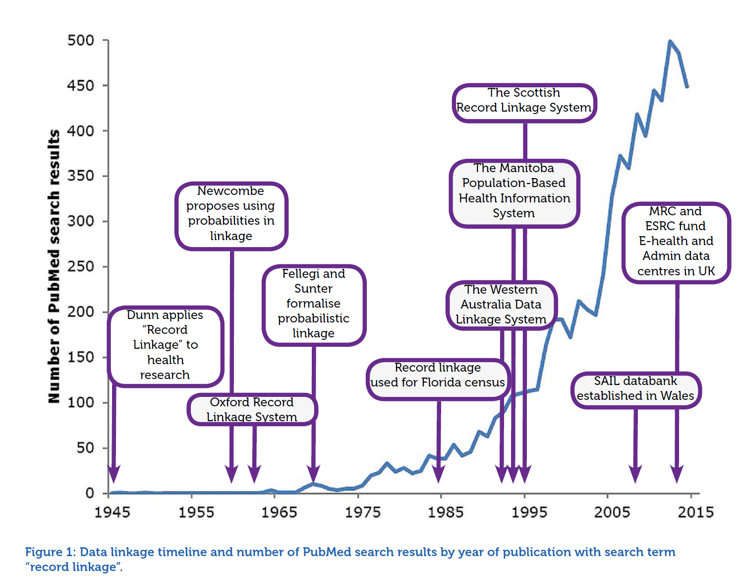
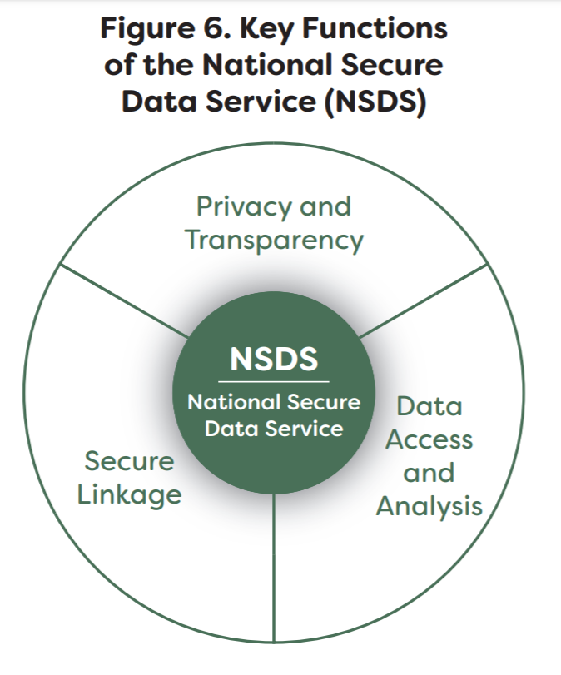
Katie Herron: Introduction to Data Linkage

Slide 7
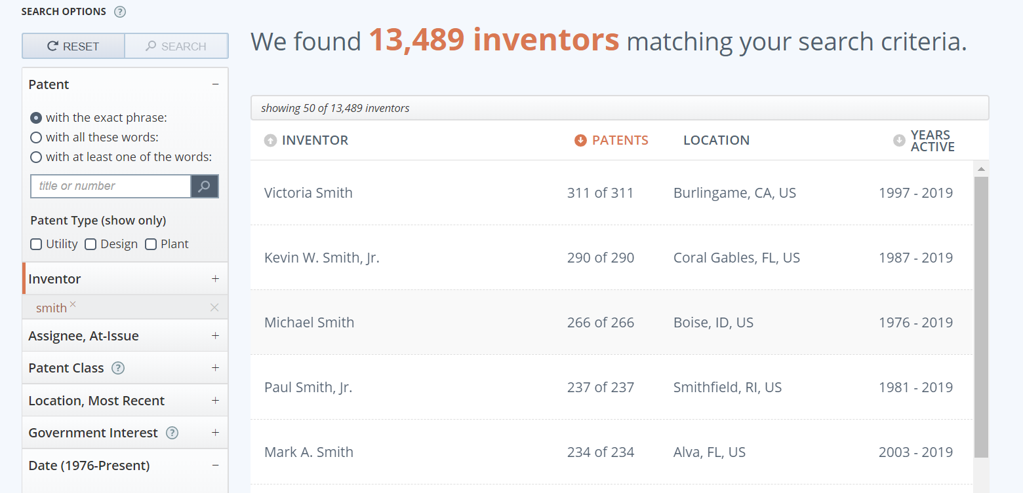
Dataset overview
https://www.patentsview.org/query/

Slide 8
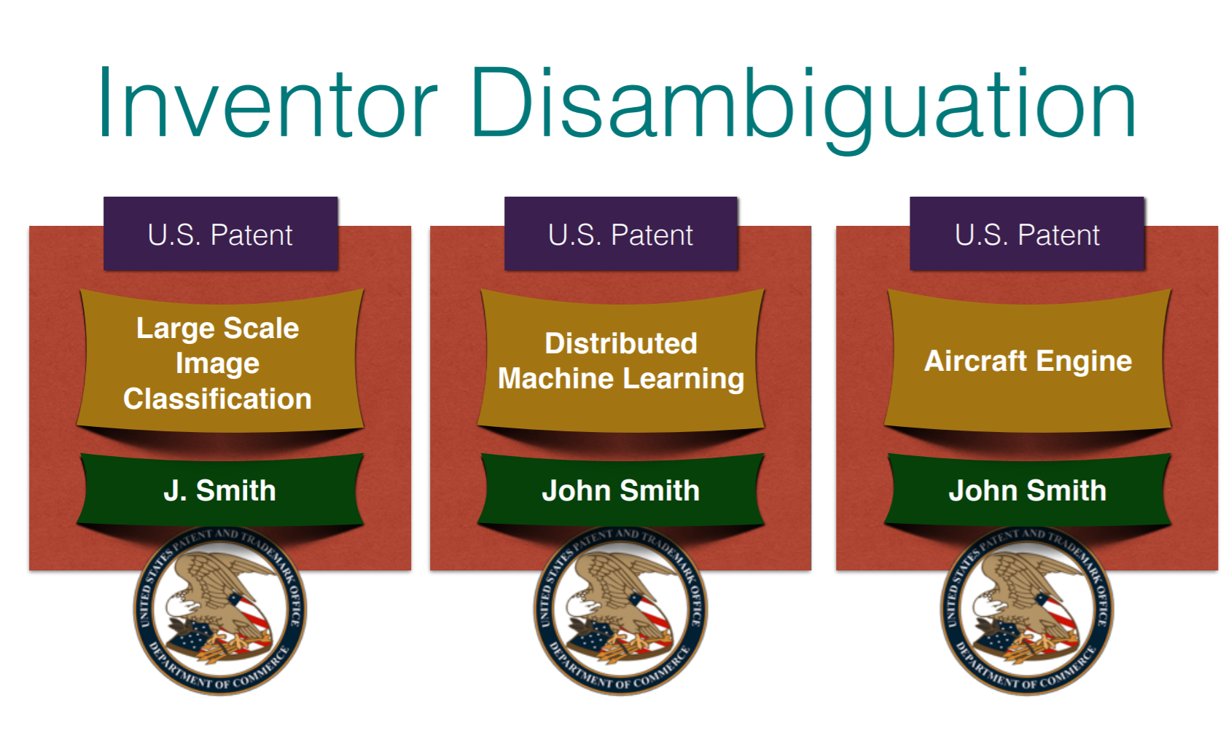
Example of Challenges

Slide 9
Many Terms
Computer science
Data matching
Object identity problem
Object consolidation
Database community
Merge-purge / list washing
Duplicate detection
Others
Identity uncertainty
Entity/reference resolution
Entity/reference disambiguation
Approximate matching

Slide 10

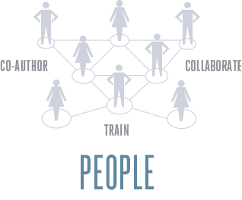

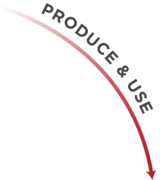



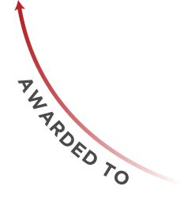


In our context

Slide 11

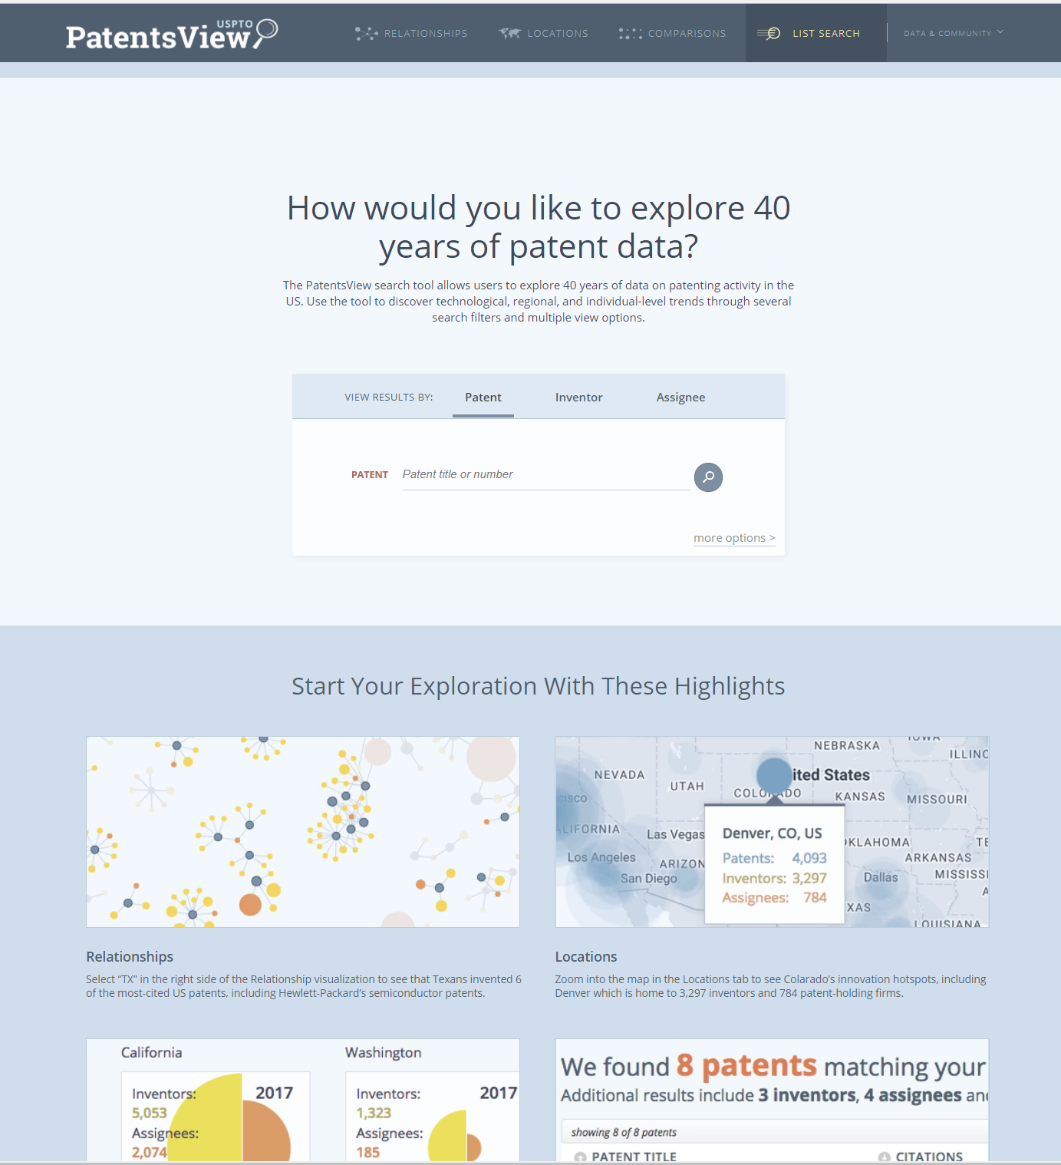
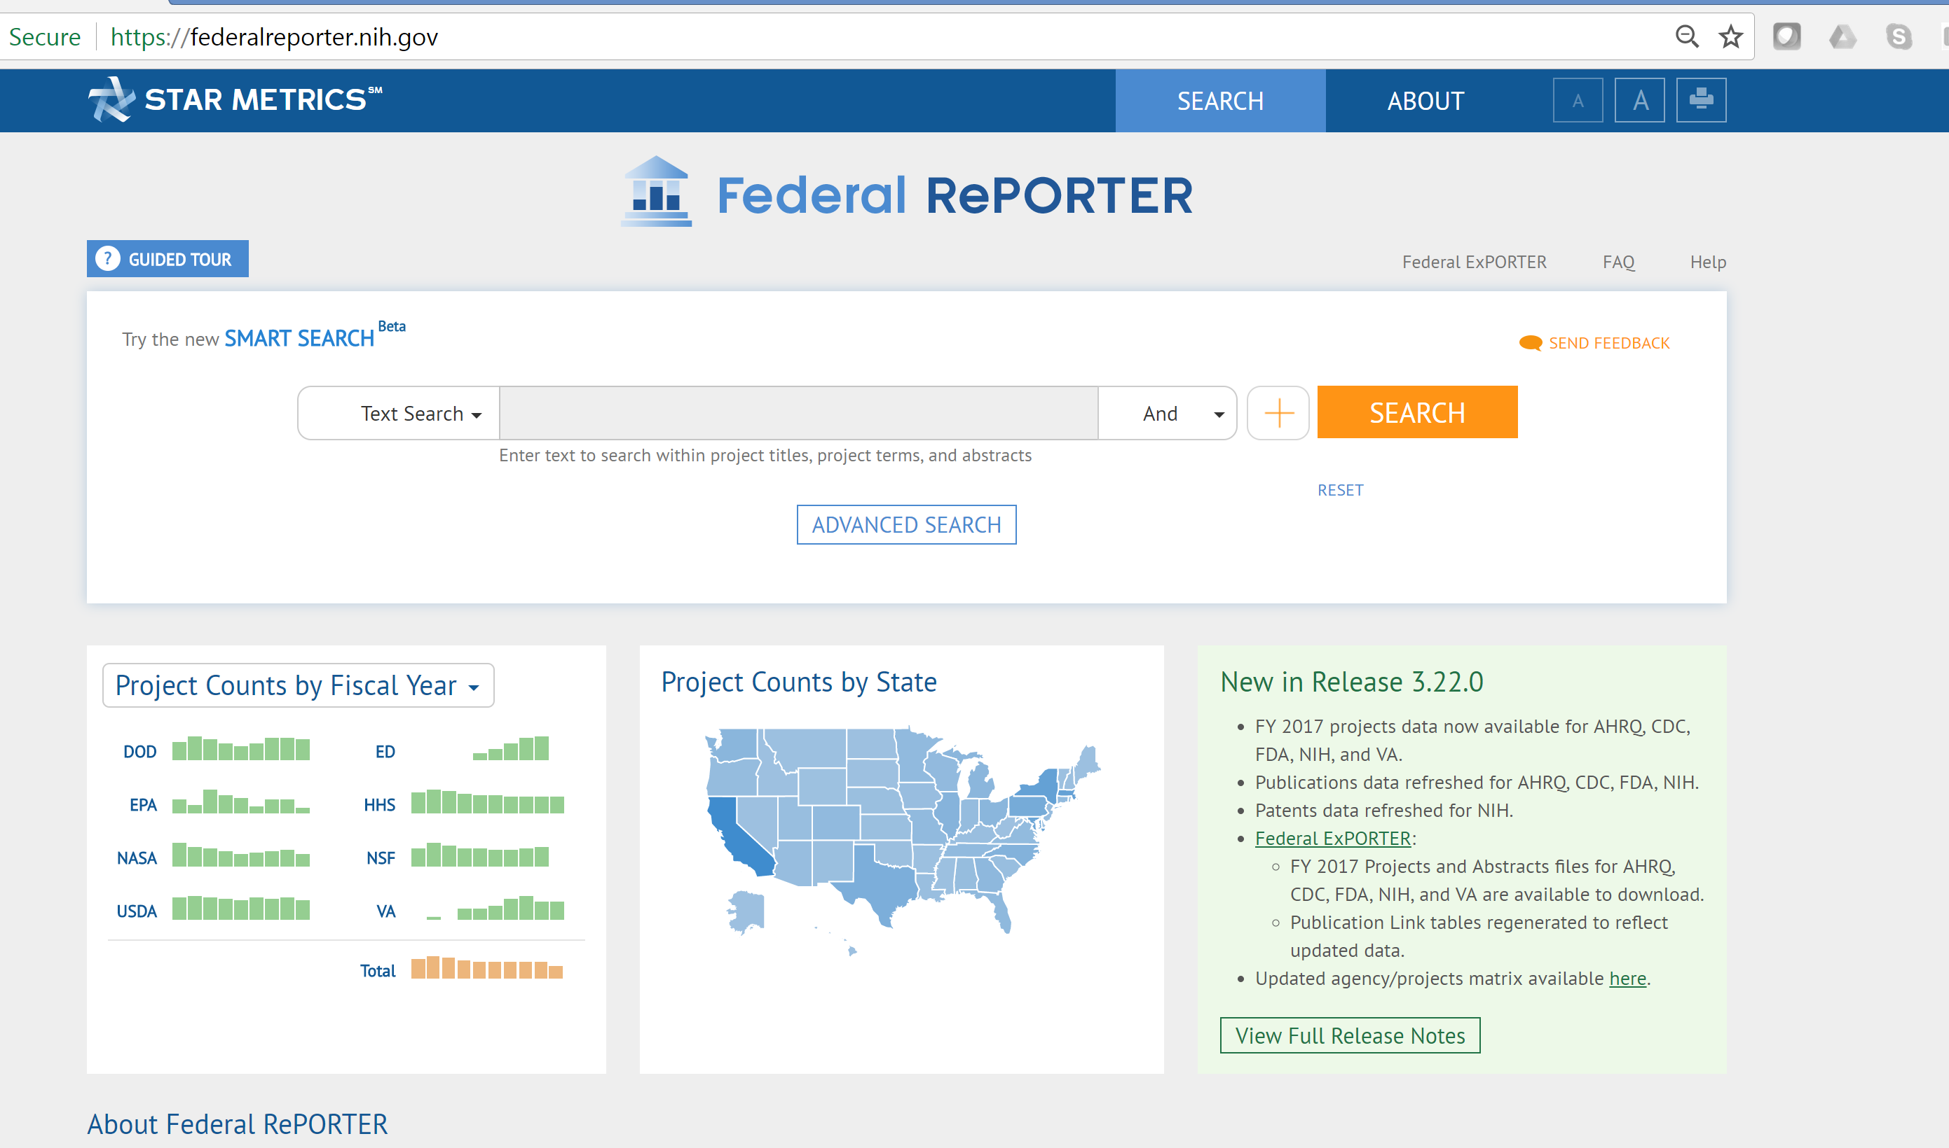
In our context

Slide 12
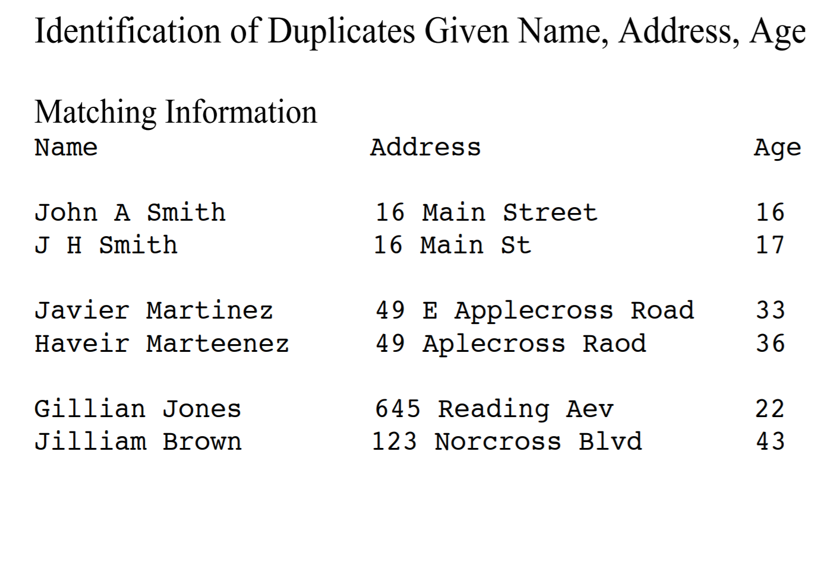
Canonical Problem

Slide 13
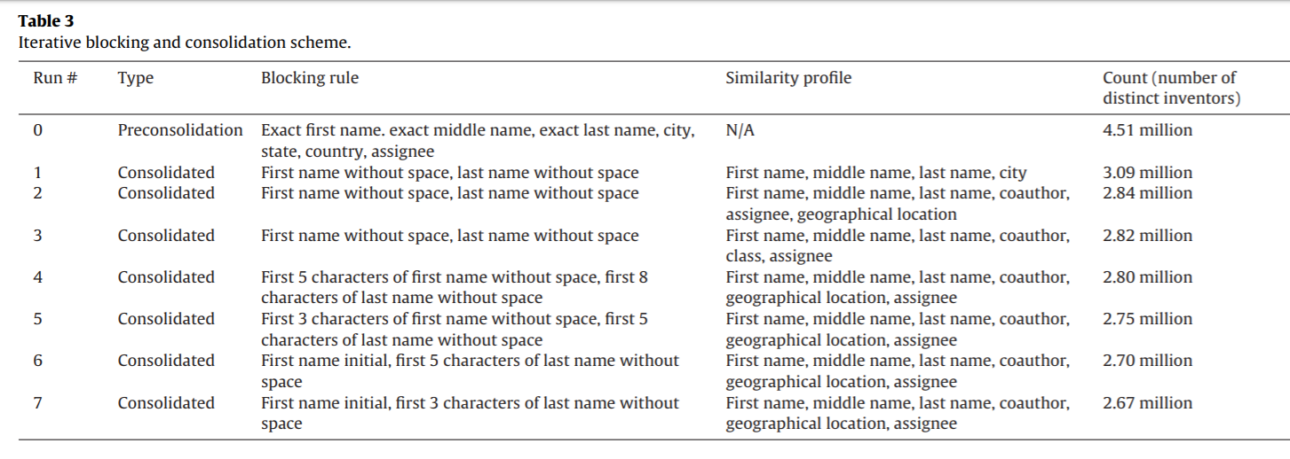
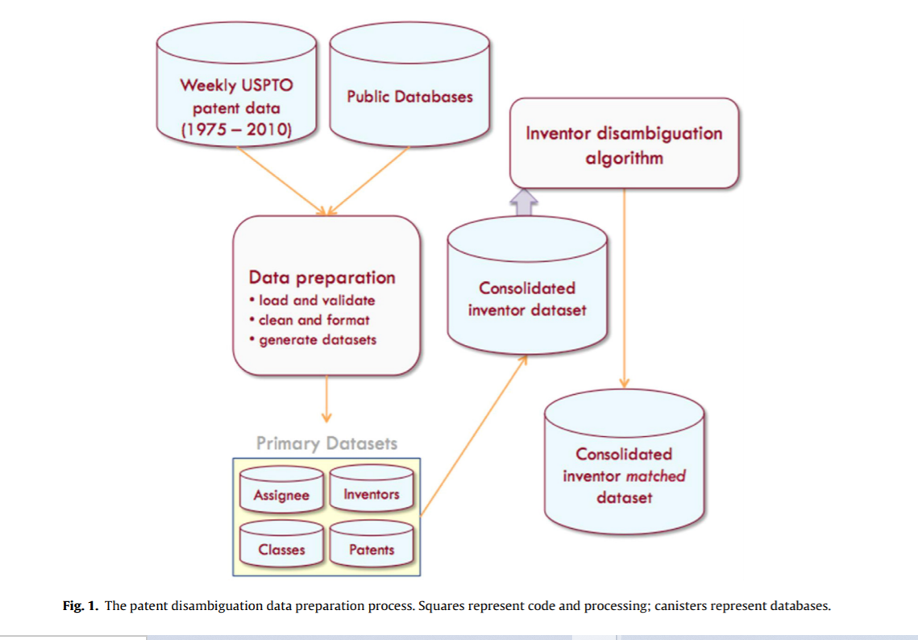
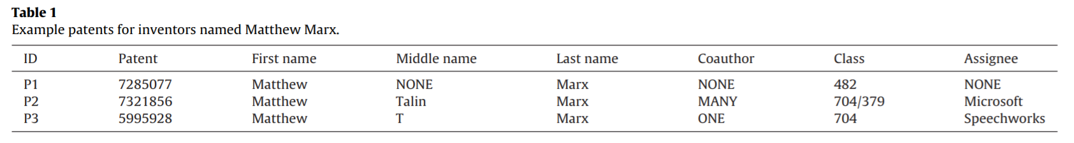
Example
http://funginstitute.berkeley.edu/wp-content/uploads/2014/05/Research-Policy.pdf

Slide 14
Overview
Context
Basics of Processing
Blocking
Linkage Approaches
Evaluation

Slide 15
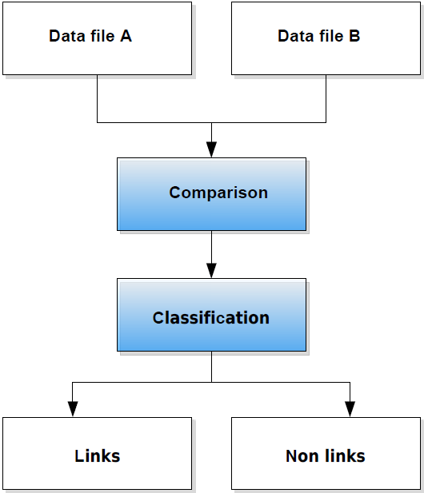
The basic record linkage process (Bender et al. 2015)

Slide 16
There is no perfect world
In a perfect world
But we do not live in a perfect world
Predicted
True Positive (TP)
 | True Negative (TN)
True
Predicted
True Positive (TP) | False Negative (FN)
False Positive (FP) | True Negative (TN)
True

Slide 17
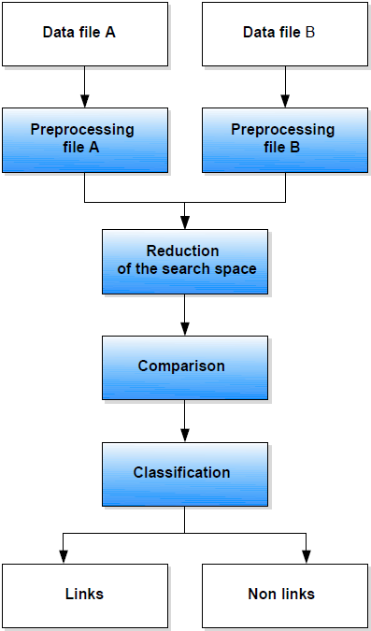
The extended RL process (Bender et al. 2015)

Slide 18
Shares of effort within linkage process
5% matching and linking efforts
20% checking that the computer matching is correct
75% cleaning and parsing the two input files
(Gill 2001, p. 31)

Slide 19
Preprocessing Basics
Typical identifiers:
People: first and last name, address, birth date, sex
Establishments / firms: name, legal form, address
The higher the number of different manifestations of an identifier, the better its suitability for a comparison.
Complex identifiers should be parsed into its separate components
Means of getting clean identifiers in the first place

Slide 20
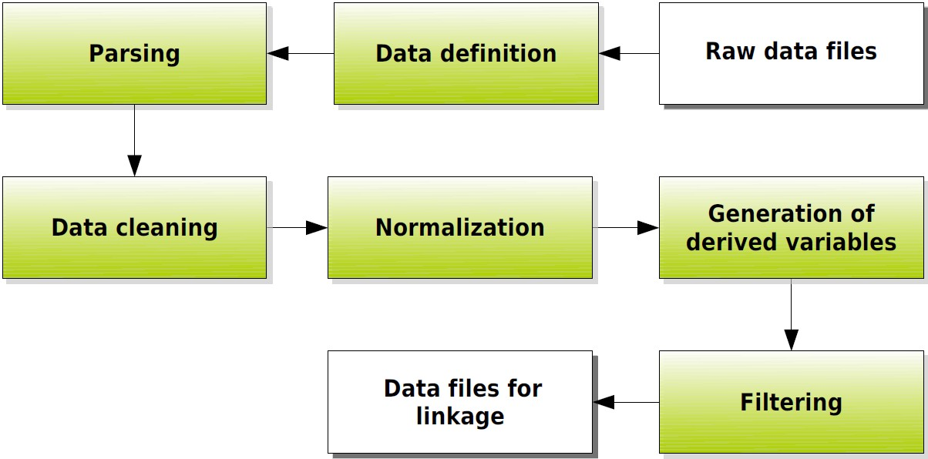
Data Preprocessing

Slide 21
Data Definition
Identify attributes :
1. Variable name, variable type, data type, missing code
2. For continuous variables: Allowed range
3. For coded categorical variables: Code list
4. For uncoded variables (respectively name variables)
regular length
regular pattern
allowed character set
excluded rules
is a list of permissible values available?

Slide 22
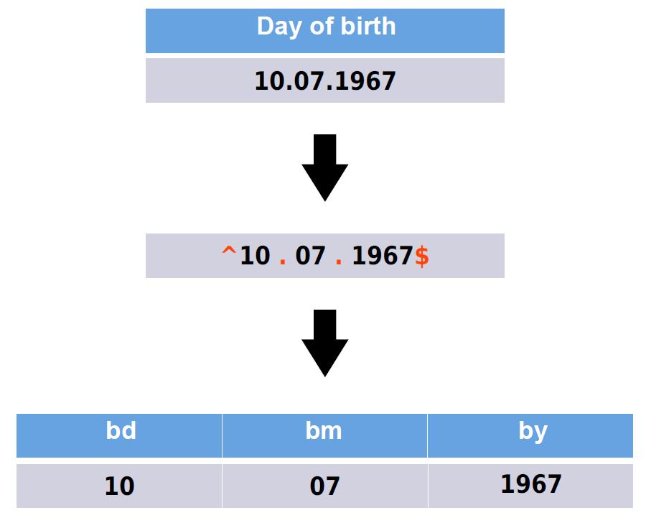

Slide 23
Parsing II
Decompose into predefined components using predefined rules
Typical procedure:
Split fields into tokens (words) on basis of delimiters
Standardize tokens by lookup tables
Categorize tokens
Identify pattern of anchors, tokens and delimiters

Slide 24
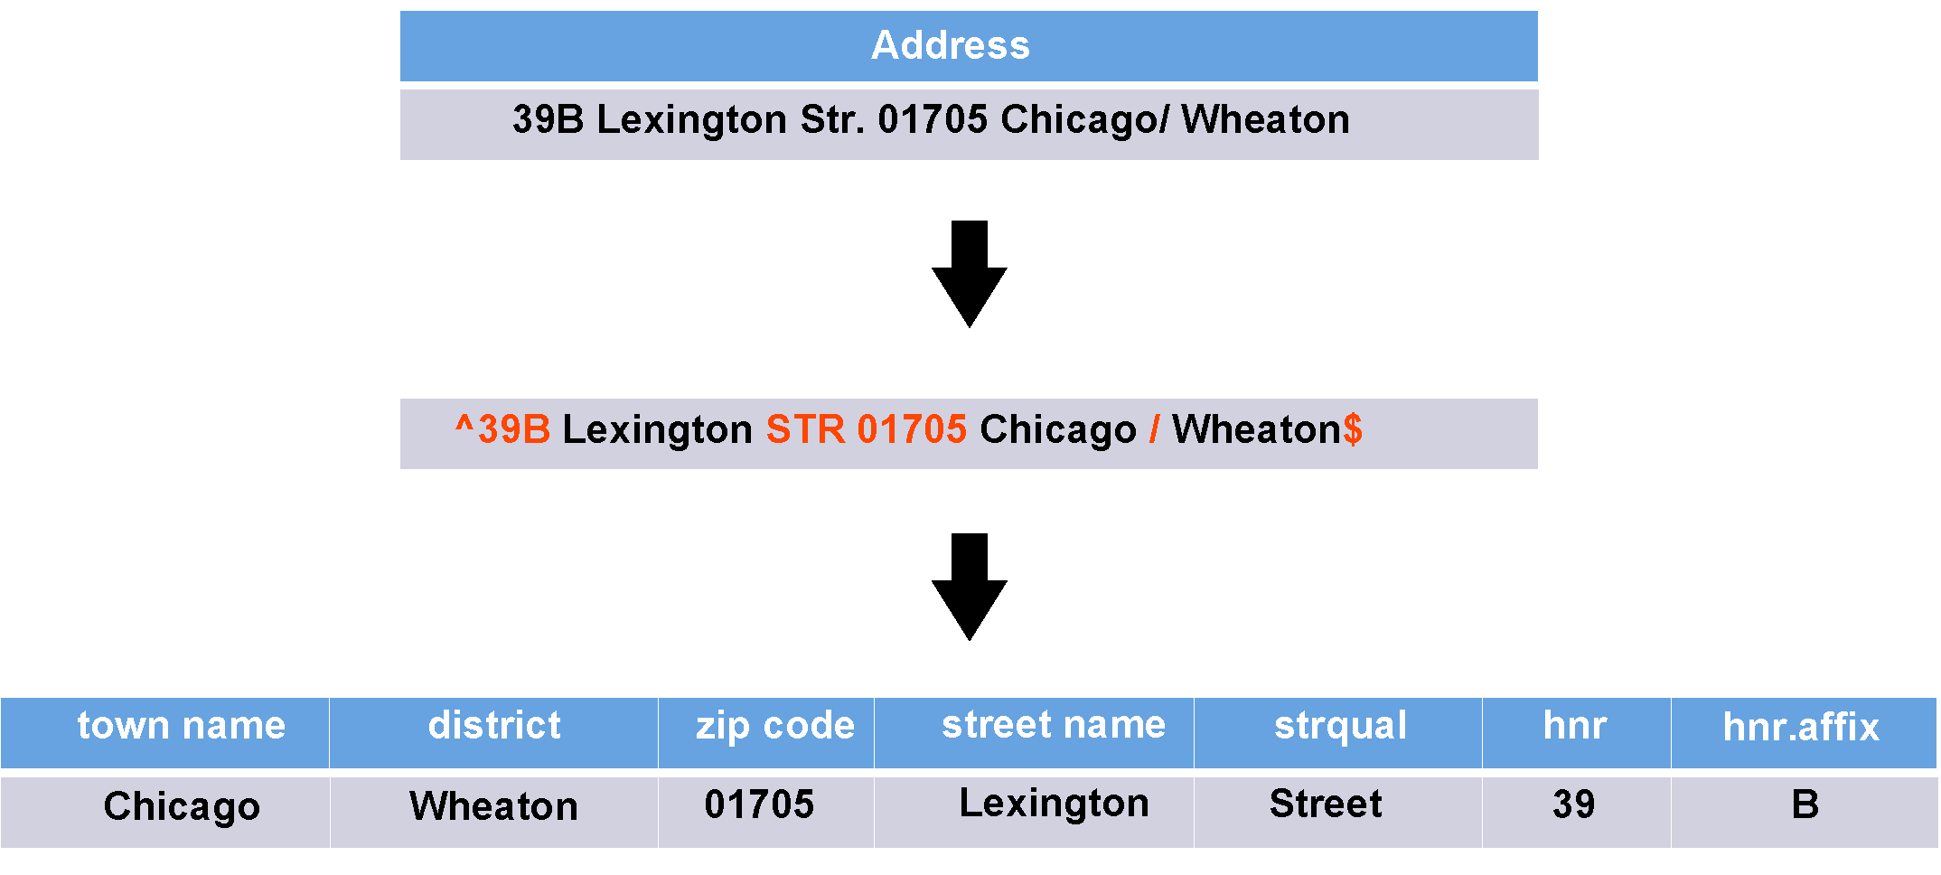

Slide 25
Example of Parsing
Parsing Out Zipcode:
Parsing Out Street Prefix:
Business Address | Zjpcode
424 Main Street, 63210 | 63201
Business Address | Street Prefix
21 W 14th Street, 62345 | W

Slide 26
Data Cleaning
Evaluation of identifiers against data definition
Checking plausibility of variable values
Checking records for consistency
Standardization
Deduplication

Slide 27
Preprocessing data
Normalization:
Lowercasing
Removing punctuation and special characters
Removing white space
e.g. Texas A&M University -> texasamuniversity
Phonetic transcriptions (soundex)

Slide 28
Preprocessing data
“In situations of reasonably high-quality data, preprocessing can yield a greater improvement in matching efficiency than string comparators and ‘optimized’ parameters. In some situations, 90% of the improvement in matching efficiency may be due to preprocessing” (Winkler 2009)¹.
Issues:
misspellings, typos (Leland Standford Junior Univsersity, Leland Standard Univ.)
abbreviated forms (Stanford Univ., Stanford Univ, Leland Stanford Jr. University)
name variants (Stanford University, Leland Stanford Junior University, The Board of Trustees of the Leland Stanford Junior University, The Regents of the Stanford Leland Junior University)
¹ Winkler, William E. 2009. “Record Linkage.” In Handbook of Statistics 29a, Sample Surveys: Design, Methods and Applications, edited by D. Pfeffermann and C. R. Rao, 351–80. Elsevier.

Slide 29
Overview
Context
Basics of Processing
Blocking
Linkage Approaches
Evaluation

Slide 30
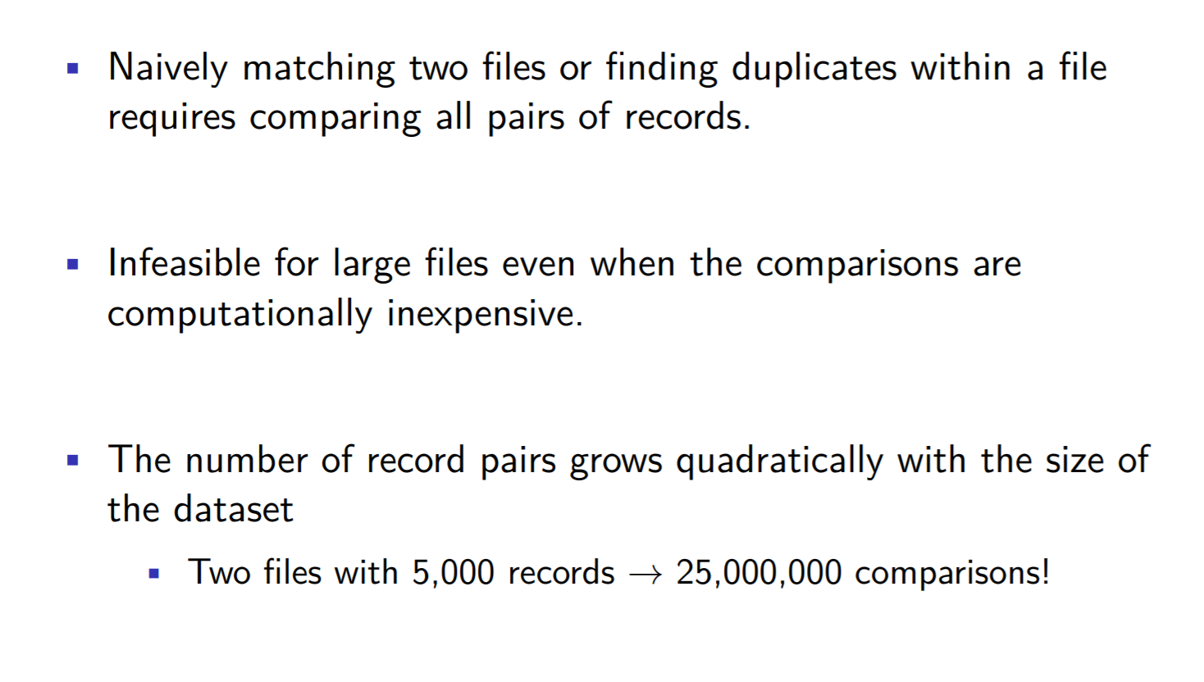
Blocking

Slide 31
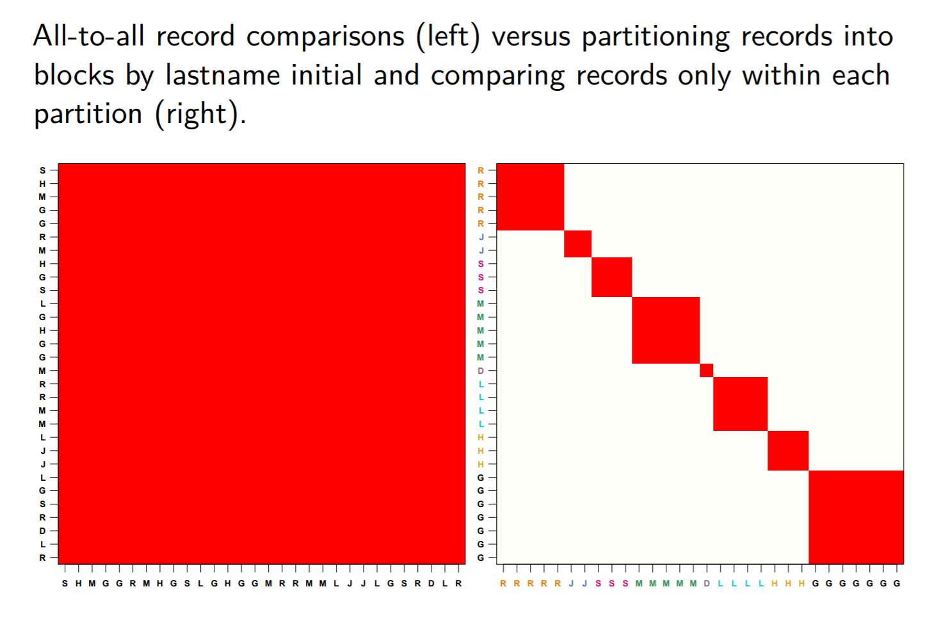
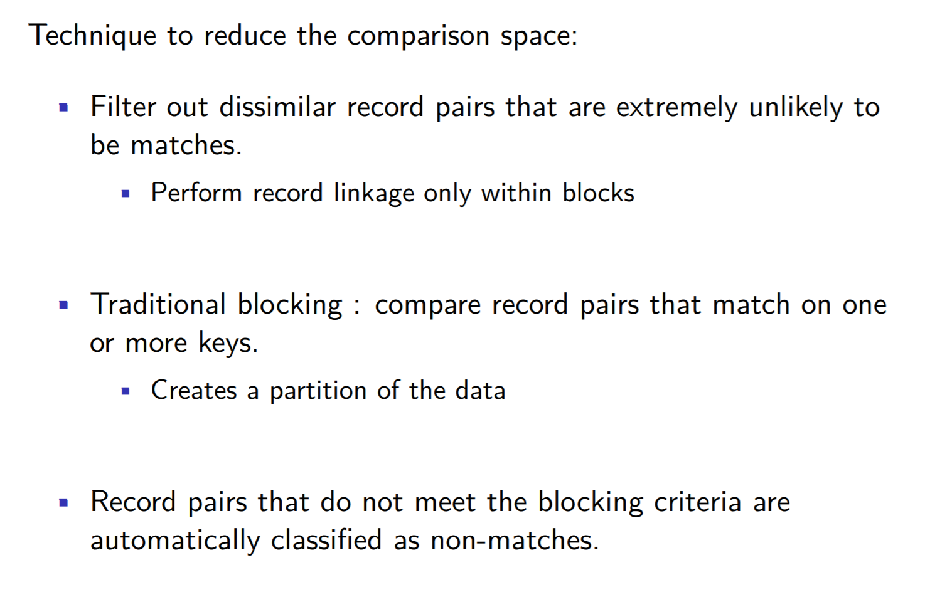
Blocking (continued)

Slide 32
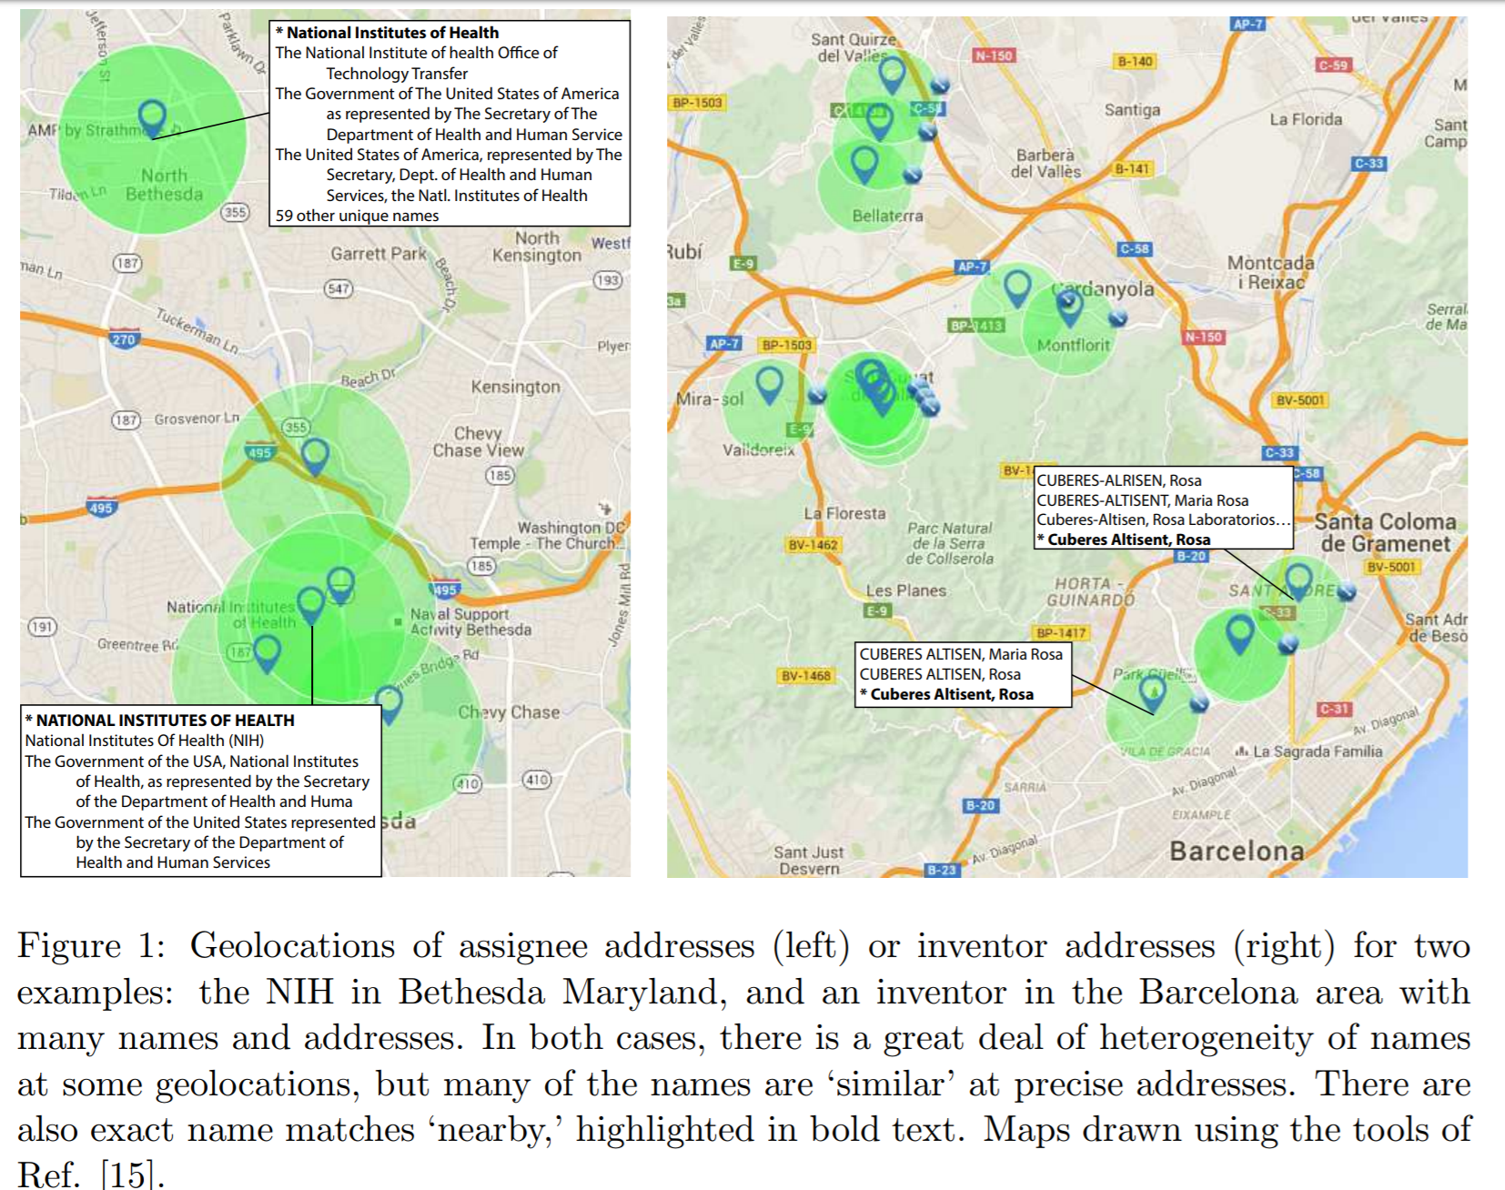
Disambiguation of Patent Inventors and Assignees Using High-Resolution Geolocation Data
Greg Morrison, Massimo Riccaboni, Fabio Pammolli; arXiv:1601.01963 [cs.DL]

Slide 33
Overview
Context
Basics of Processing
Blocking
Linkage Approaches
Rule based
Probabilistic
Machine Learning
Evaluation

Slide 34
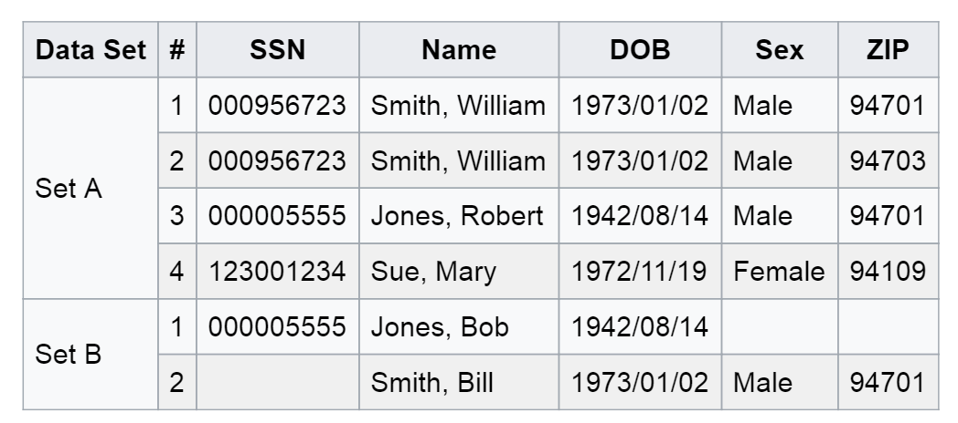
Deterministic (rule based) linkage
simplest method of matching
sort/merge exact match
works best with single unique identifier (key)
Identifiers
have equal weight
chosen by researcher or availability
Works well if keys are perfect and present in all datasets you want to link. In Example one key not enough (missing data), next key (name) has errors in it
Example: https://en.wikipedia.org/wiki/Record_linkage

Slide 35
Overview
Context
Basics of Processing
Blocking
Linkage Approaches
Evaluation

Slide 36
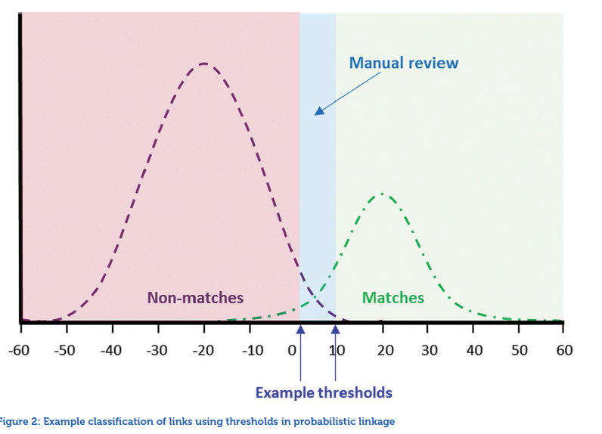
Probabilistic Record Linkage
Source: ADRN : Introduction to Record Linkage

Slide 37
Probabilistic Record Linkage
Basic idea by Newcombe & Kennedy (1962), Theory Fellegi & Sunter (1969)
Allows wider range of potential identifiers
Computing weights based on estimated ability to match or not match (frequency ratios)
Unlike rule based method, algorithms can be trained
Problem: Estimating errors and thresholds, independence assumption, clerical review, individual variables not string
Often used:
M-probability: probability that a field agrees given that the pair of records is a true match
U-probability: probability that a field agrees given that the pair of records is NOT a true match
U probability for birth month 1/12 appx. 0.083

Slide 38
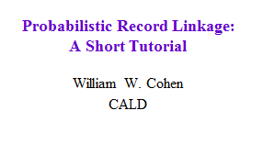
Felligini-Sunter: notation
Two sets to link: A and B
A x B = {(a,b) : a ϵ A, b ϵ B} = M U U
M = matched pairs, U= unmatched pairs
Record for a ϵ A is α(a), for b ϵ B is β(b)
Comparison vector, written γ(a,b), contains “comparison features” (e.g., “last names are same”, “birthdates are same year”, …)
γ(a,b)=f( γ¹(α(a),β(b)),…, γ^{K}(α(a),β(b))
Comparison space Γ = range of γ(a,b)

Slide 39
Back to Canonical Problem

Slide 40
Approach in practice
each matching variable is compared and assigned a score (weight) based on how well it matches
frequency analysis of data values is important
uncommon value agreement stronger evidence for linkage (e.g. Anastasia vs. John)
calculates a score for each field that indicates, for any pair of records, how likely it is that they both refer to the same entity
sum the scores over fields
sort record pairs in order of their scores (weights)
BLOCKING really critical

Slide 41
Factors Influencing Likelihood of Match
Reliability of data fields
Greater reliability results in increased odds of correct match
A match on a high-quality, reliably entered field is good
Not matching on a poor-quality field with lots of known data entry errors may not be a fatal error
If a field is pure noise, correct matches will be random across the databases
Probabilistic Linkage: Issues and Strategies: Craig A. Mason, Ph.D. University of Maine

Slide 42
Factors Influencing Likelihood of Match
Frequency of field values
The more common the value in a field, the greater the odds that the records will be erroneously matched
A match based on the name Zbignew is a relatively good indicator of a match, even if there may be disagreement in other fields
A match based on the name John may be of much less value, requiring matches on more fields in order to conclude two records are the same individual
Number of expected matches one would obtain randomly
Probabilistic Linkage: Issues and Strategies: Craig A. Mason, Ph.D. University of Maine

Slide 43
Probabilistic Matching
w₁
w₂
If the field agrees, w_{i} is equal to ….

Slide 44
Main issues in F-S model
Modeling and training:
How do we estimate m(γ), u(γ) ?
Making decisions with the model:
How do we set the thresholds?
Feature engineering:
What should the comparison space Γ be?
Distance metrics for text fields
Normalizing/parsing text fields
Efficiency issues:
How do we avoid looking at |A| * |B| pairs?

Slide 45
Overview
Context
Basics of Processing
Blocking
Linkage Approaches
Rule based
Probabilistic
Machine Learning
Evaluation

Slide 46
Summary: Record Linkage Technique (Christen 2015)
Deterministic matching
Rule-based matching (complex to build and maintain)
Probabilistic record linkage (Fellegi and Sunter, 1969)
Use available attributes for linking (often personal information, like names, addresses, dates of birth, etc.)
Calculate match weights for attributes
“Computer science” approaches
Based on machine learning, data mining, database, or information retrieval techniques

Slide 47
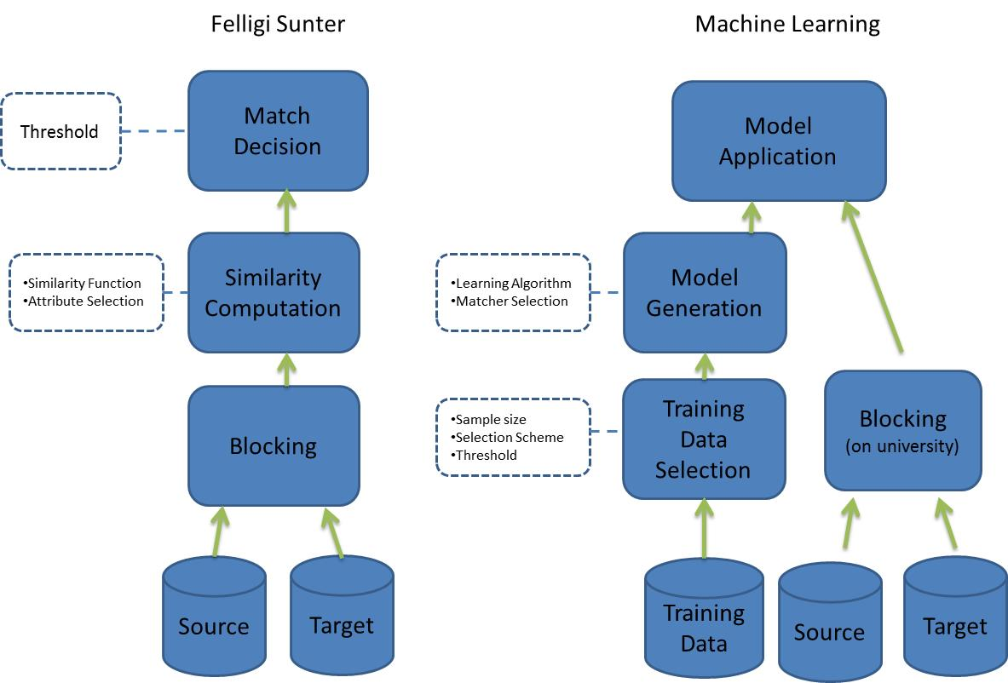
Approaches to linking:
Probabilistic vs Machine Learning

Slide 48
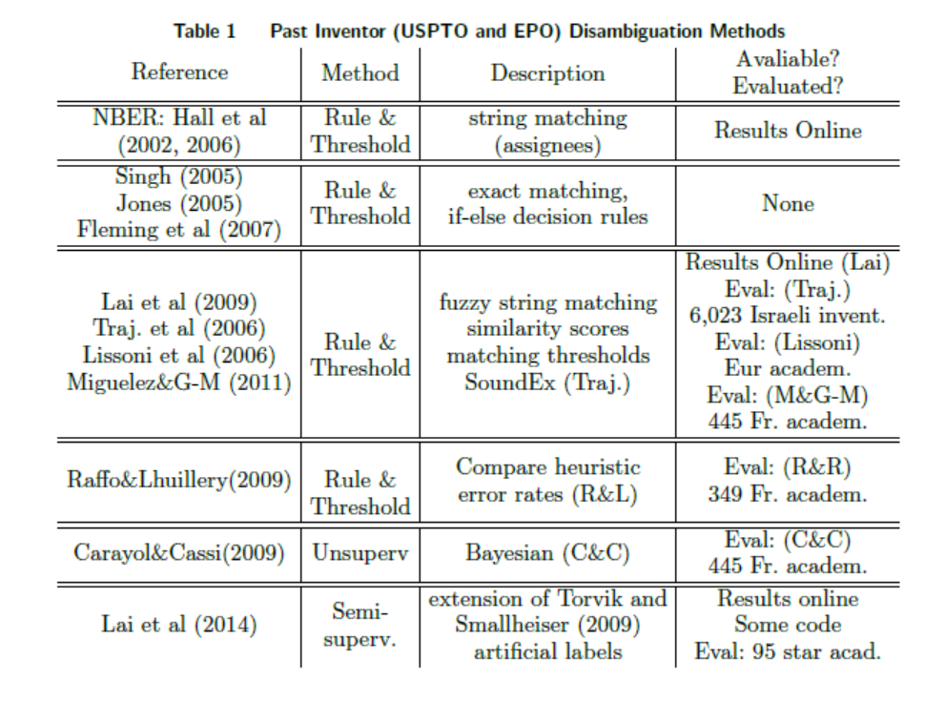

Slide 49
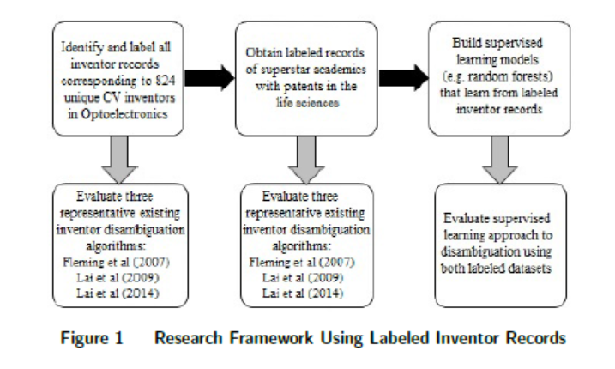

Slide 50
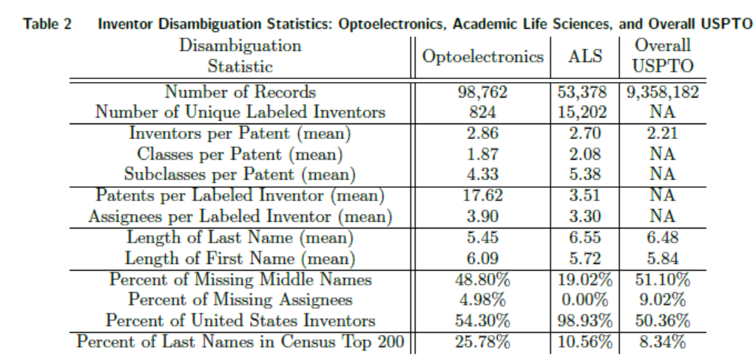

Slide 51
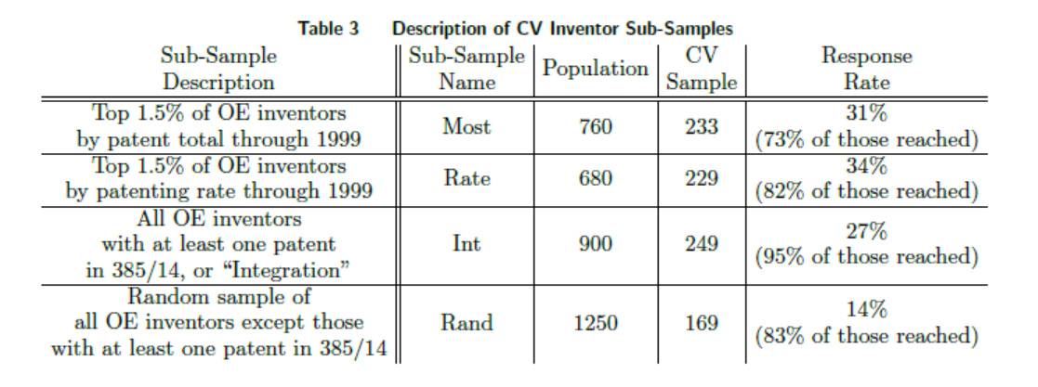

Slide 52
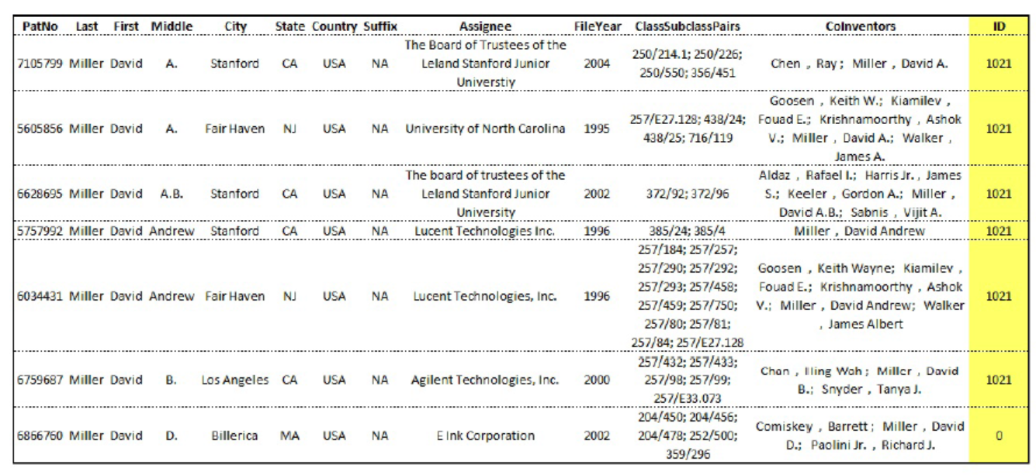

Slide 53
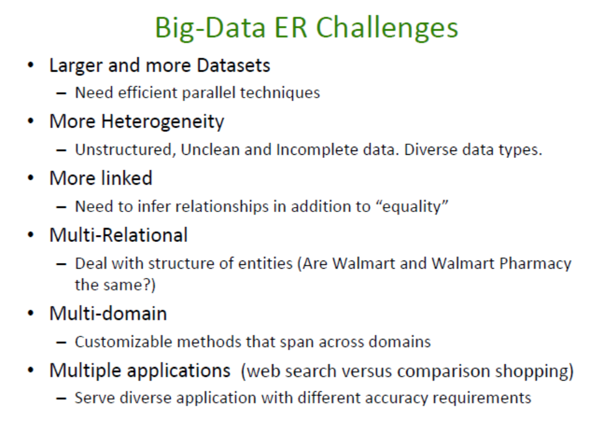
Entity Resolution: Tutorial http://www.cs.umd.edu/~getoor/Tutorials/ER_VLDB2012.pdf

Slide 54
Machine Learning
“A computer program is said to learn from experience E with respect to some task T and some performance measure P, if its performance on T, as measured by P, improves with experience E.”

Slide 55
Types of Learning
Unsupervised
Clustering
PCA
Association Rules
…
Supervised
Classification
Regression
…

Slide 56
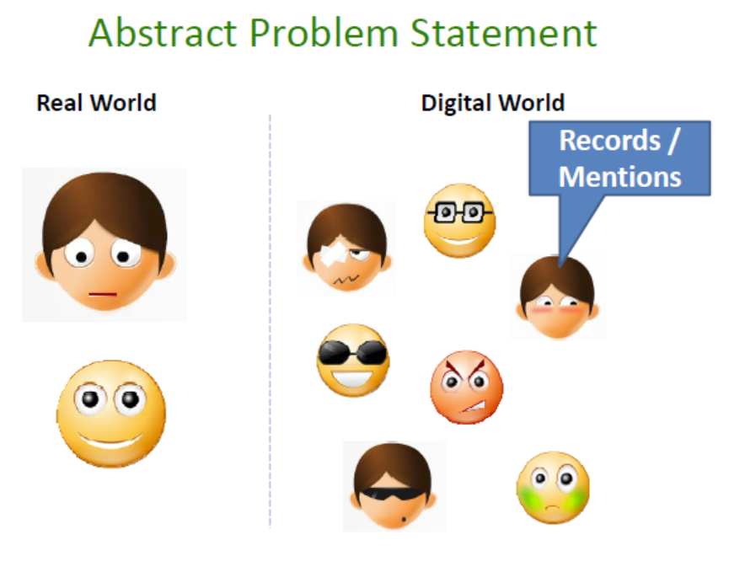

Slide 57
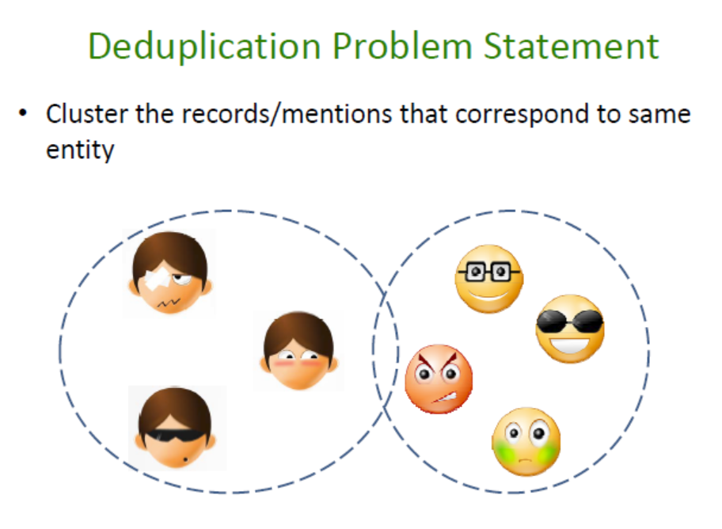

Slide 58
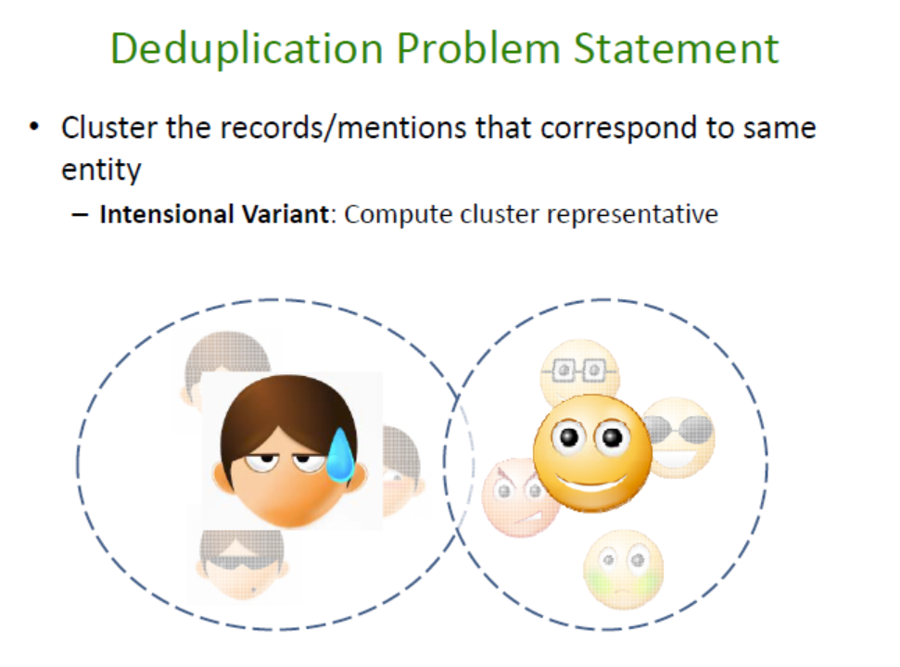

Slide 59
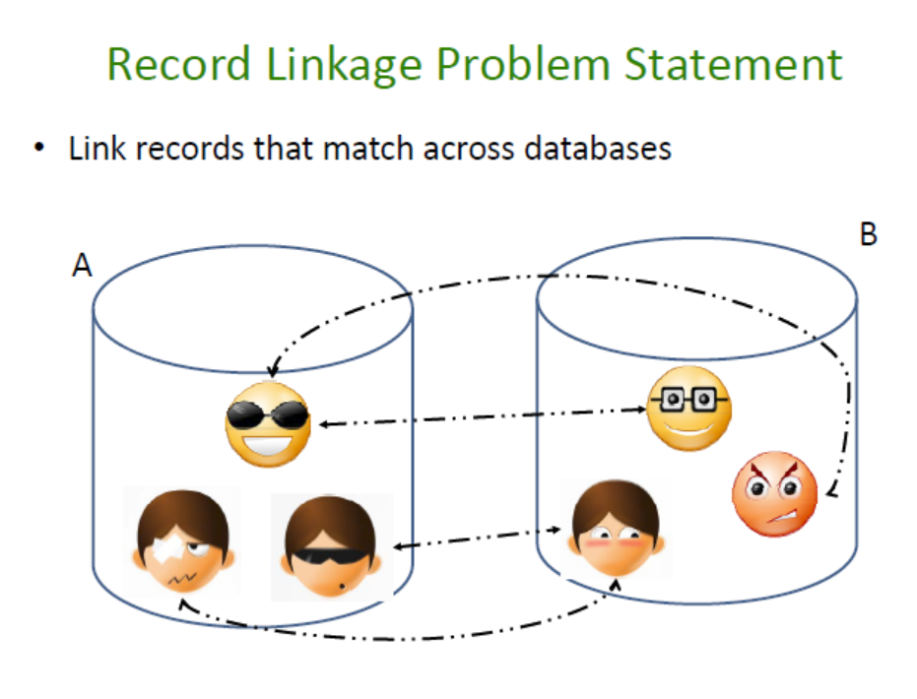

Slide 60
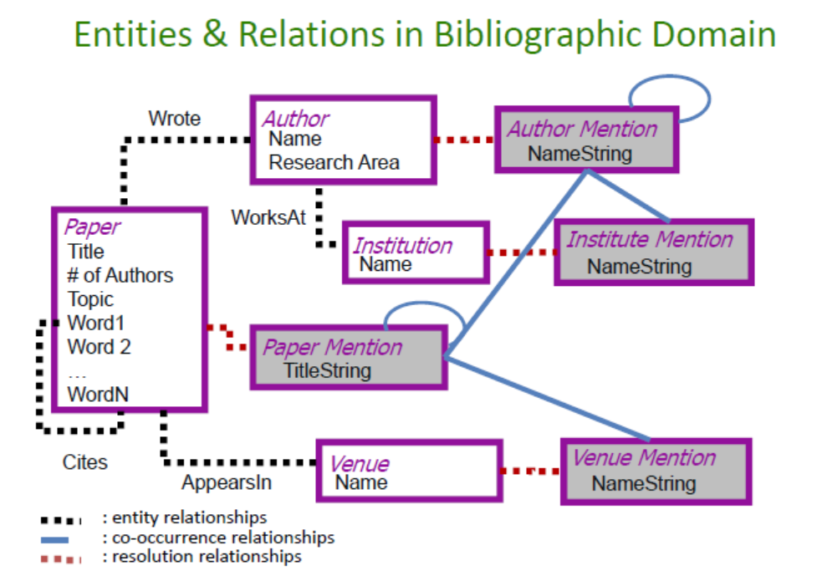

Slide 61
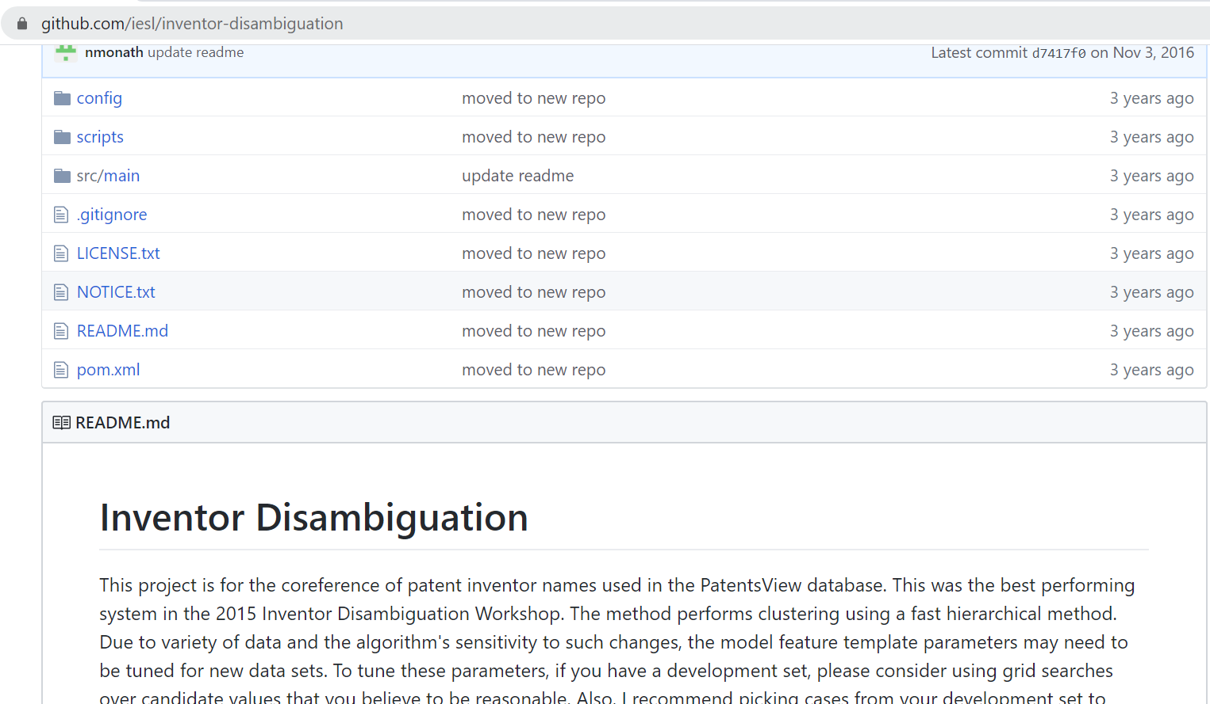
Nicholas Monath and Andrew McCallum. Discriminative Hierarchical Coreference for Inventor Disambiguation. Presentation. PatentsView Inventor Disambiguation Technical Workshop. September 2015 [slides] [code]

Slide 62
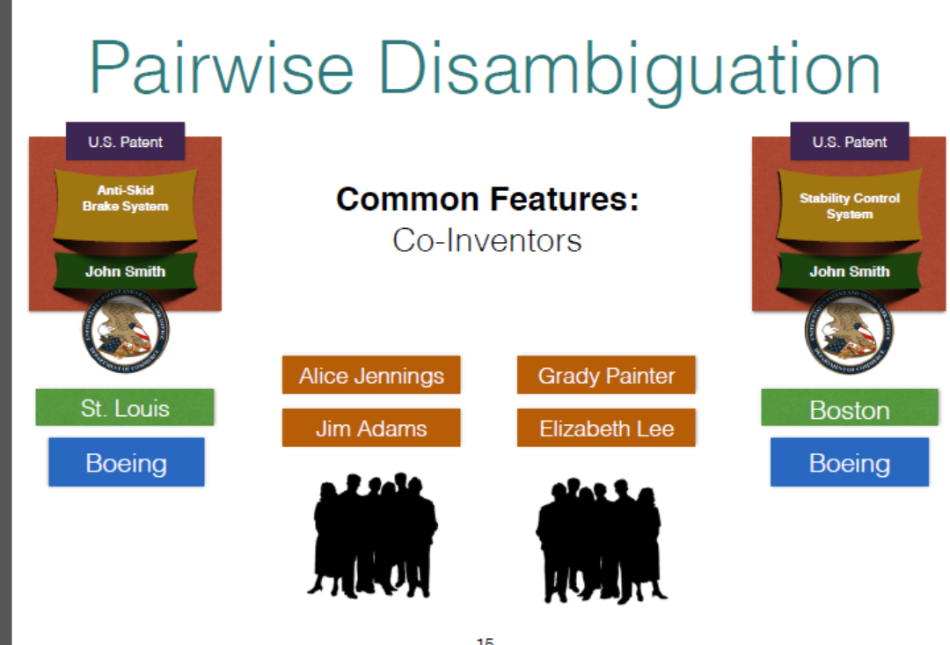

Slide 63
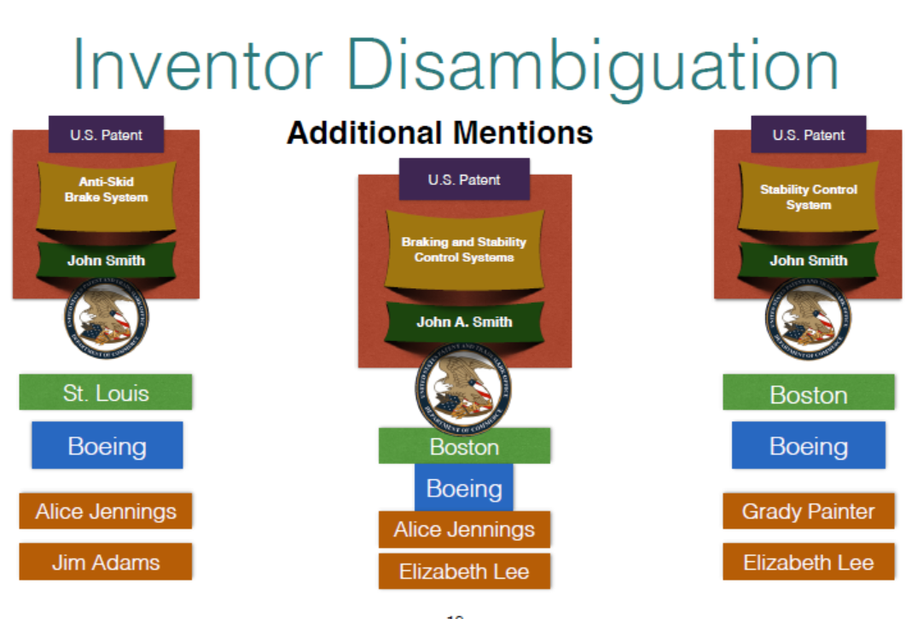

Slide 64
Overview
Context
Basics of Processing
Blocking
Linkage Approaches
Evaluation

Slide 65
There is no perfect world
In a perfect world
But we do not live in a perfect world
Predicted
True Positive (TP)
 | True Negative (TN)
True
Predicted
True Positive (TP) | False Negative (FN)
False Positive (FP) | True Negative (TN)
True

Slide 66

Evaluation
Two types of accuracy errors.
A Type I error occurs when a true nonmatch is classified as a match.
A Type II error occurs when a true match is classified as a nonmatch.
Minimizing these errors is critical, particularly when the product will be used in a cohort study
Four metrics most often used to evaluate the accuracy of a linkage algorithm are:
Sensitivity TP / (TP+FN) – correct classification of true matches
Specificity FP / (FP+TN) – correct classification of true non matches
positive predictive value (PPV) TP / (TP + FP) – proportion of matched pairs classified as matches that are true matches
negative predictive value(NPV). TN / (FN + TN) – proportion of matched pairs classified as non matches that are true non matches

Slide 67
Note – think about loss function
If focus is true cases, then investigators may want to focus on sensitivity.
If focus is minimize false positives, the researcher may focus on specificity.

Slide 68
Other measures
Note that most of comparison space is true non matches (e.g., specificity and NPV)
F-Measure is ((β² + 1.0) * Sensitivity * PPV) / (β² * Sensitivity + PPV)
Harmonic mean β is equal to the user-assigned relative importance of sensitivity over PPV.

Slide 69
Summary: Record Linkage Technique (Christen 2015)
Deterministic matching
Rule-based matching (complex to build and maintain)
Probabilistic record linkage (Fellegi and Sunter, 1969)
Use available attributes for linking (often personal information, like names, addresses, dates of birth, etc.)
Calculate match weights for attributes
“Computer science” approaches
Based on machine learning, data mining, database, or information retrieval techniques

Slide 70
Summary: Challenges (Christen 2012)
Scalability
Naïve comparison of all record pairs is quadratic
Remove likely no-matches as efficiently as possible
Need efficient etchniques
More linked / multi-relational
Need to infer relationship
No training data in many linkage applications
No record pairs with known true match status

Slide 71

Invaluable sources

